Slide 1
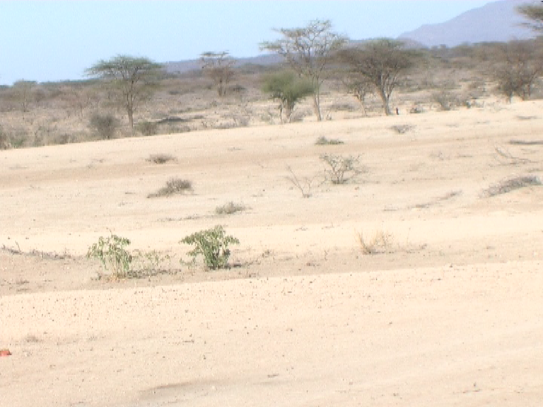
Drought in Kenya

Slide 2
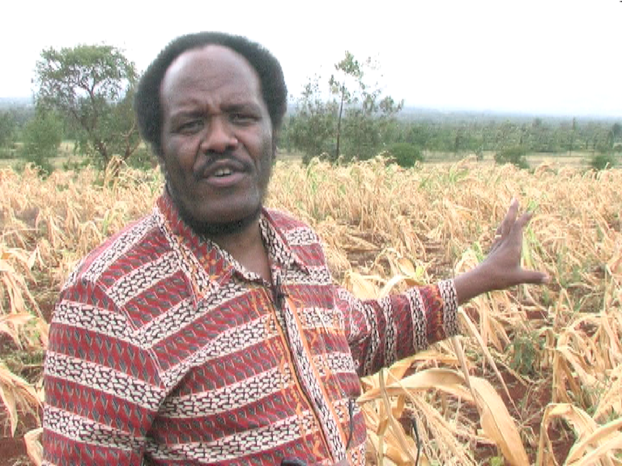
Crop failure in the ‘bread-basket’
of Kenya

Slide 3
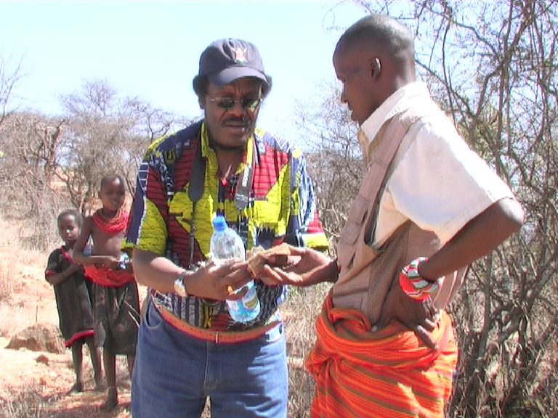

Slide 4
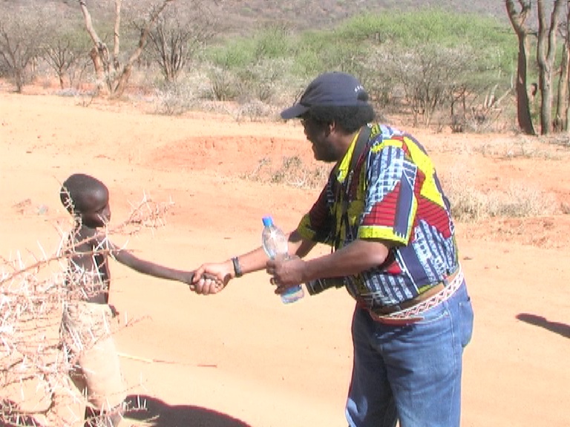

Slide 5
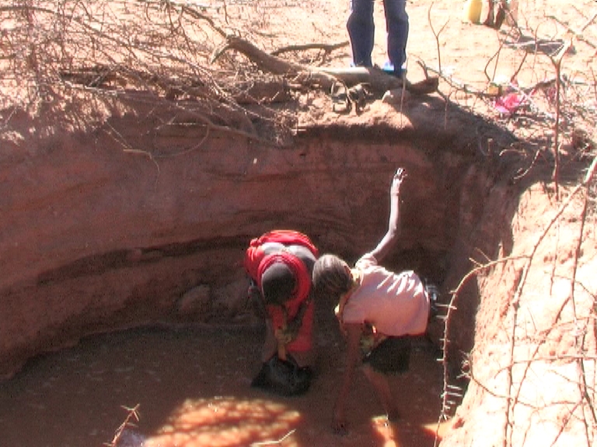
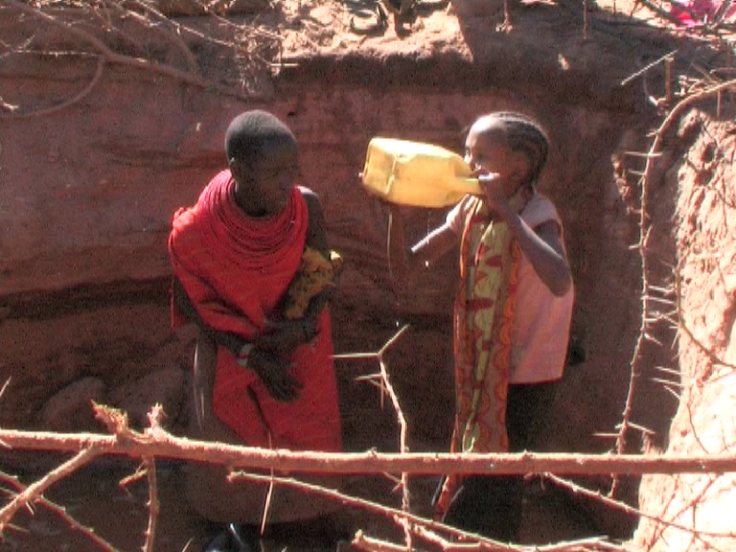
4 hour walk to reach heavily contaminated water

Slide 6
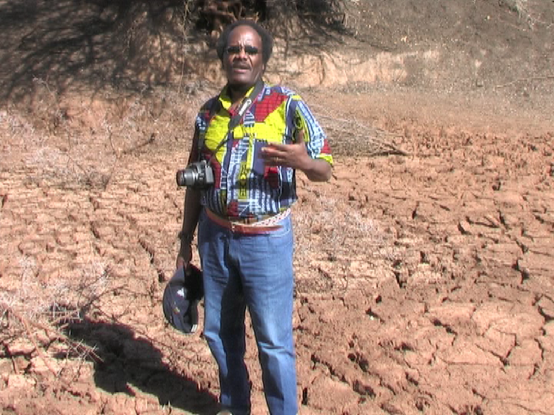
Are you able to help us?

Slide 7

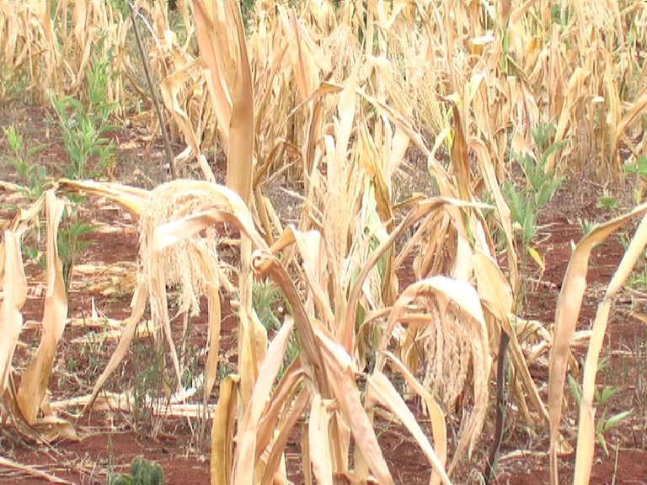
Cheques to:
‘Newfrontiers’
(Kenya Crisis Fund)
The Matrix Complex
91 Peterborough Road
London SW6 3BU
Give Online at:
www.newfrontierstogether.org

